Slide 1

Artificial Intelligence for Business Decisions and Transformation
CSCN8030 - Spring 2024 - Section 2
Sprint 2 - Demo
10 June 2024
Group 4 - Members:
Krishna Kumar, Hemasree
Shijin, Jency
Fernandez, Arcadio
Professor:
Glaucia Melo dos Santos, PhD

Slide 2
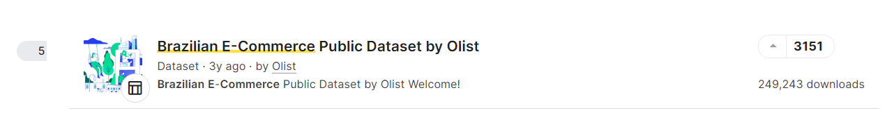
https://www.kaggle.com/datasets/olistbr/brazilian-ecommerce

Slide 3
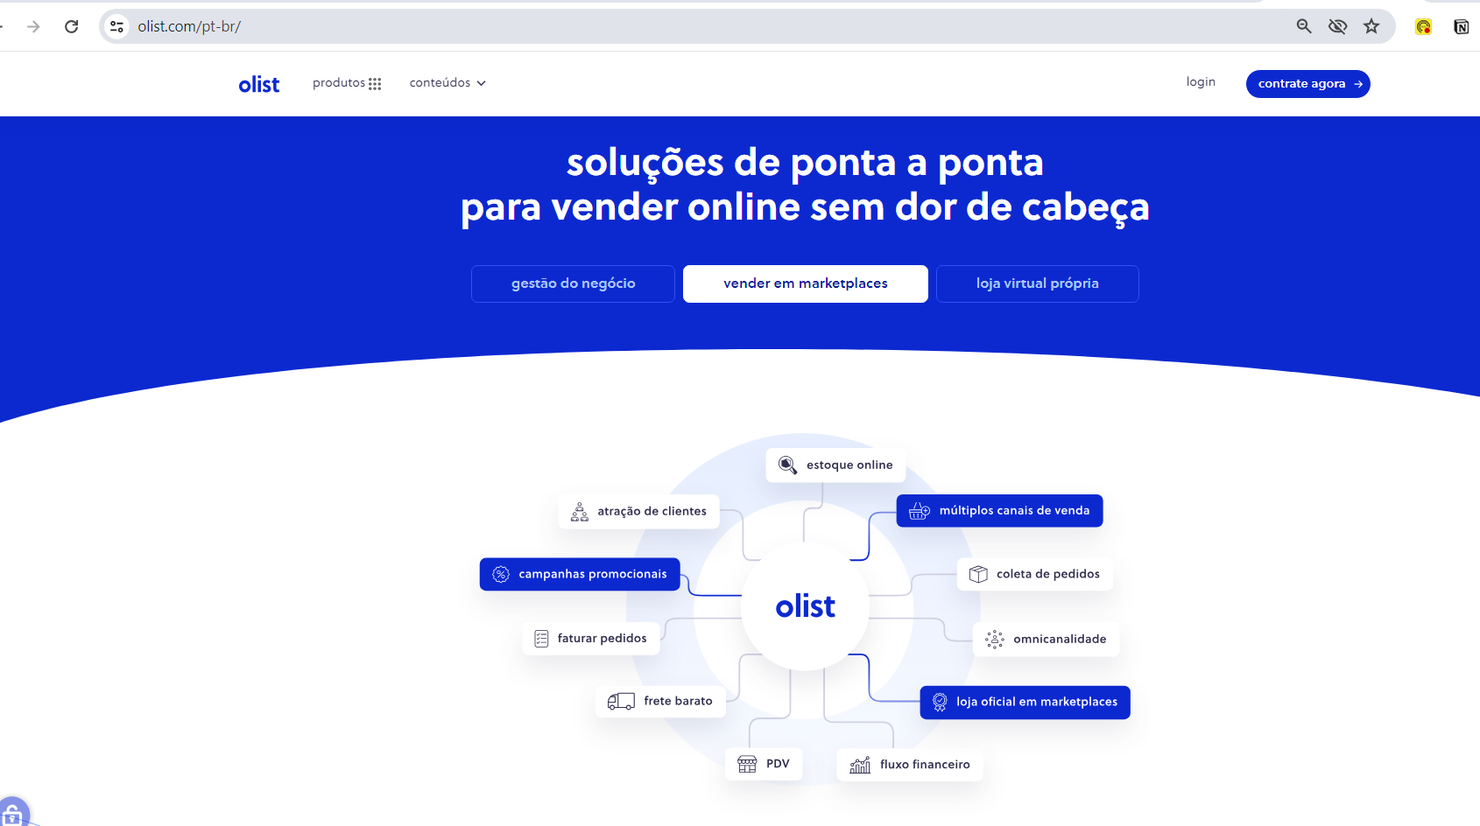
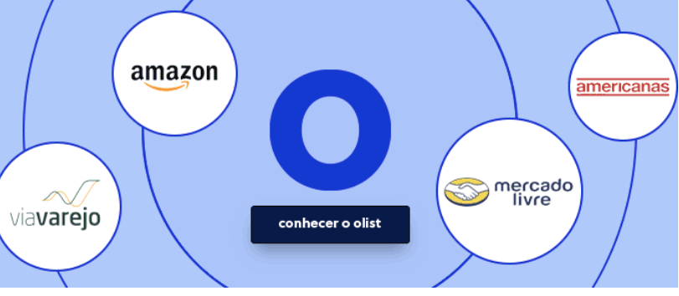
Olist is a leading ecosystem in solutions for selling online formed by olist store, Vnda and Tiny. Digital products are aimed at retailers and brands from all segments, with high technology and integrated to assist in the growth and increase revenue of small, medium and large companies.

Slide 4
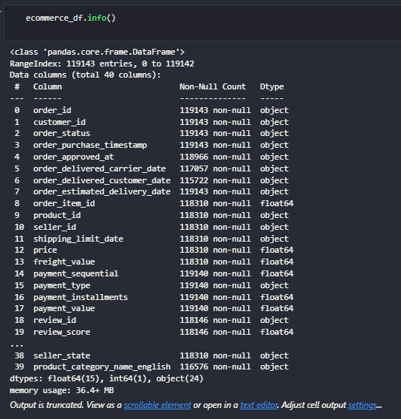

Slide 5
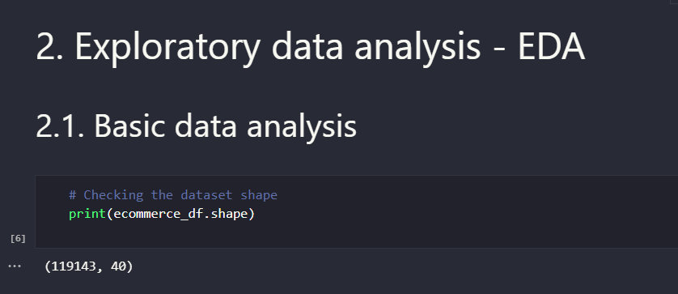

Slide 6
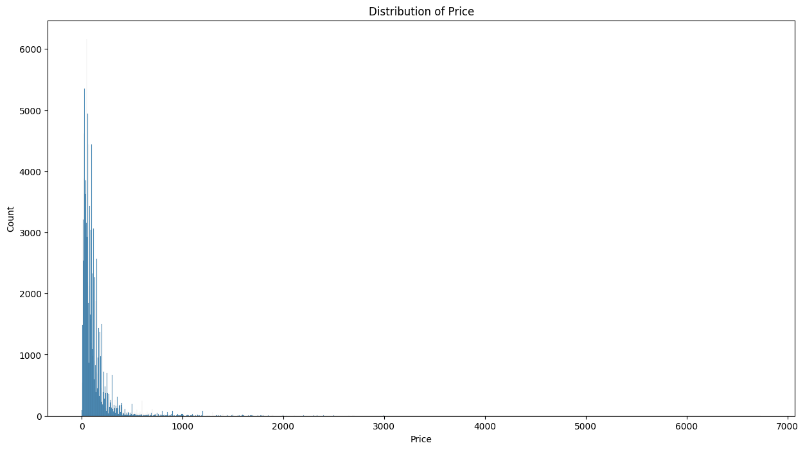

Slide 7
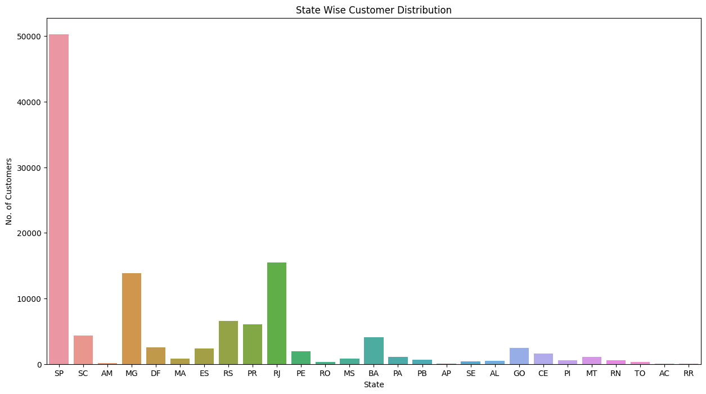

Slide 8
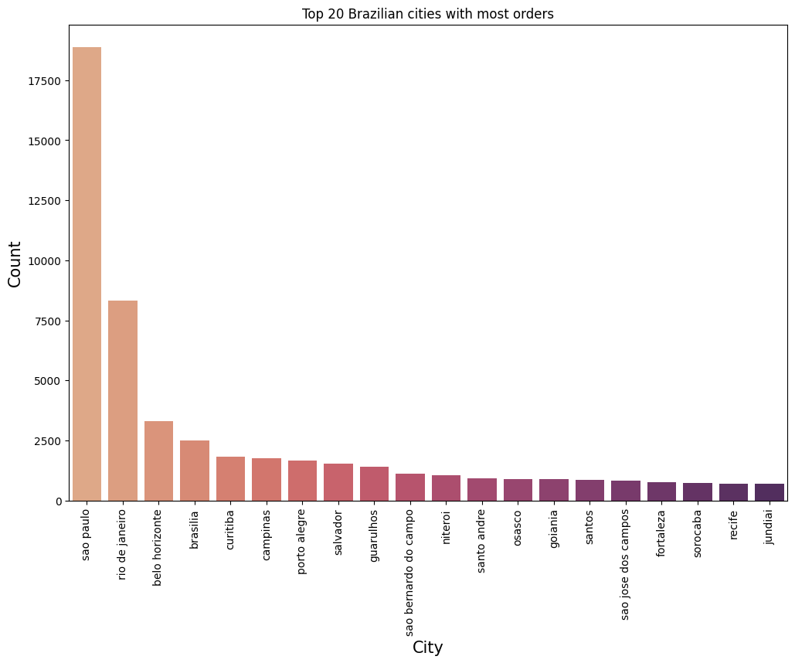

Slide 9
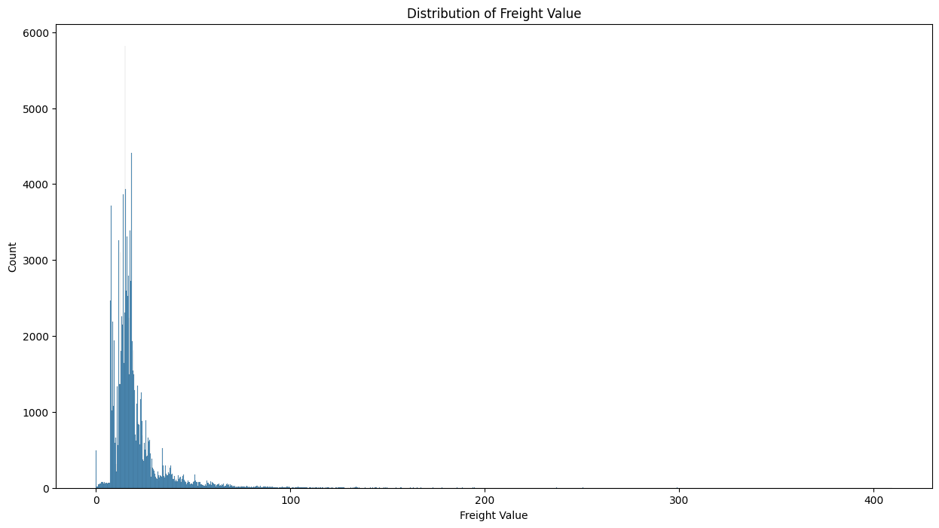

Slide 10
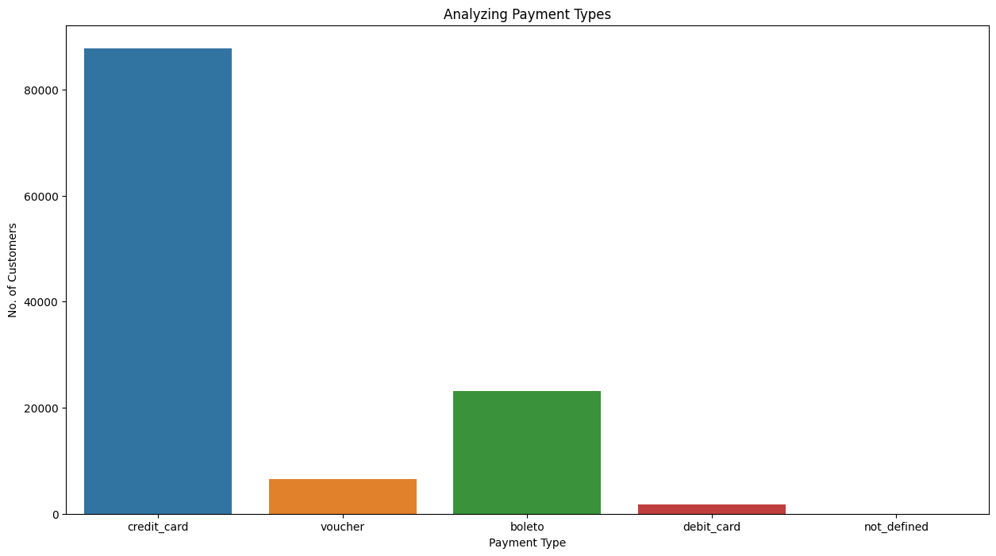

Slide 11
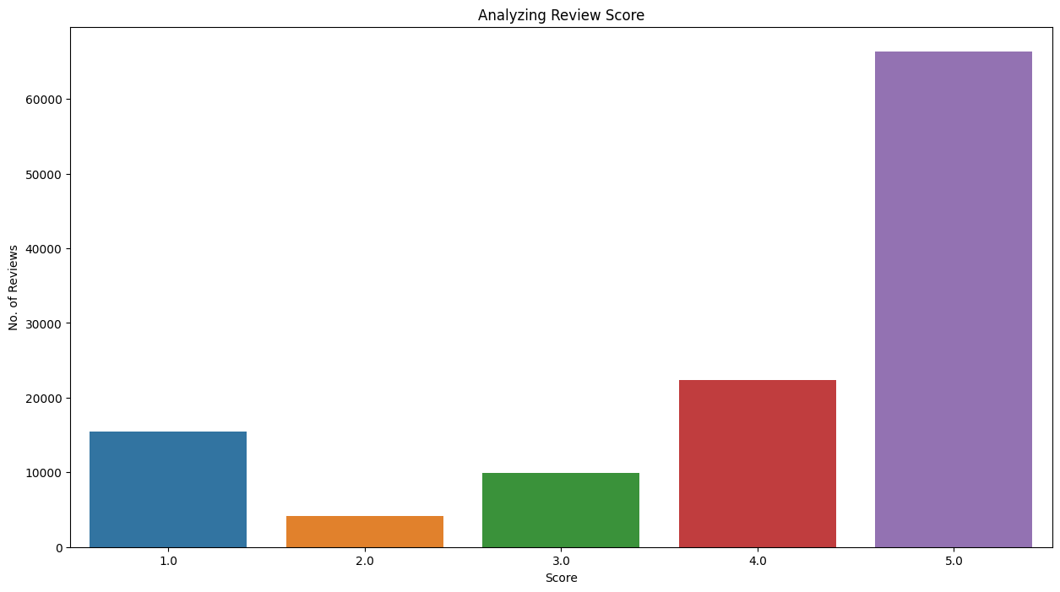

Slide 12
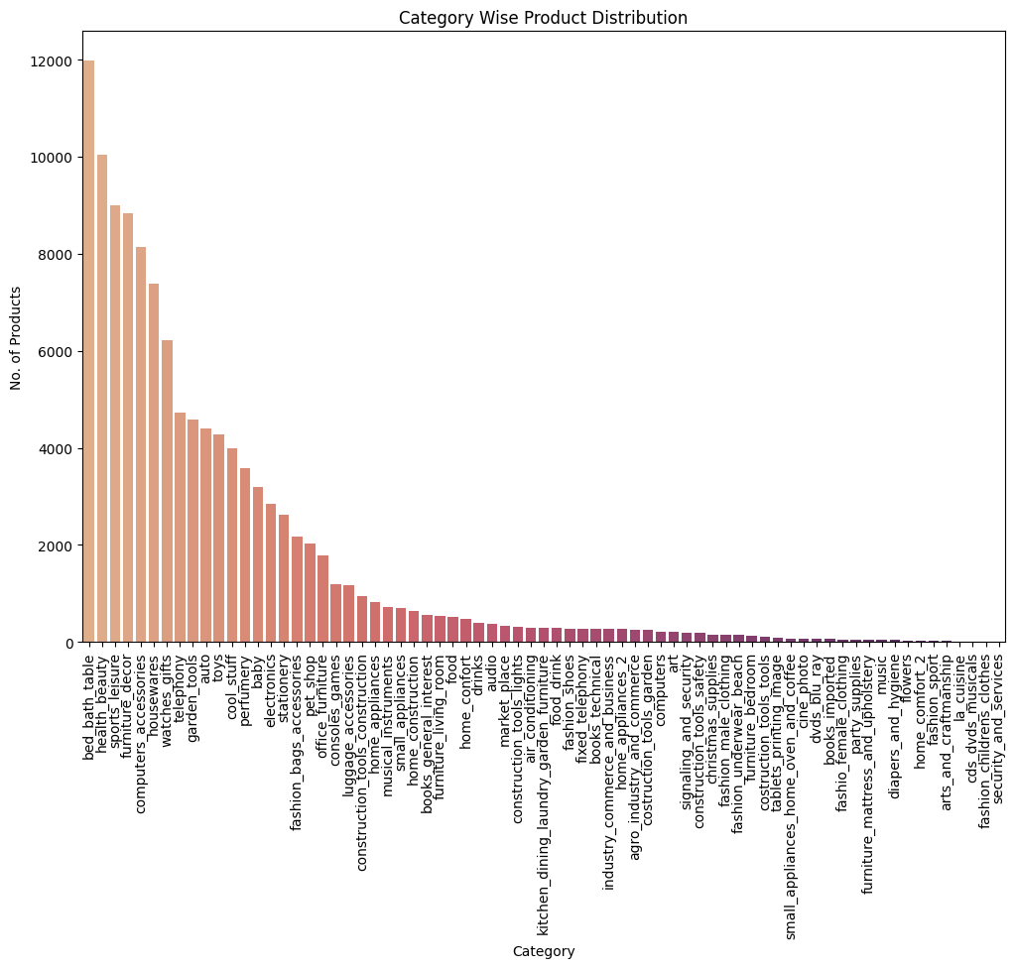

Slide 13
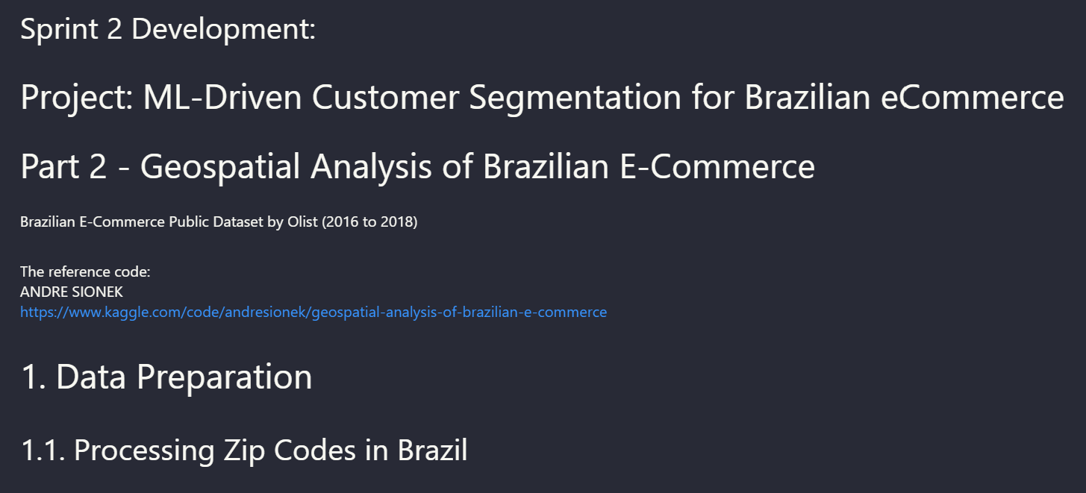

Slide 14
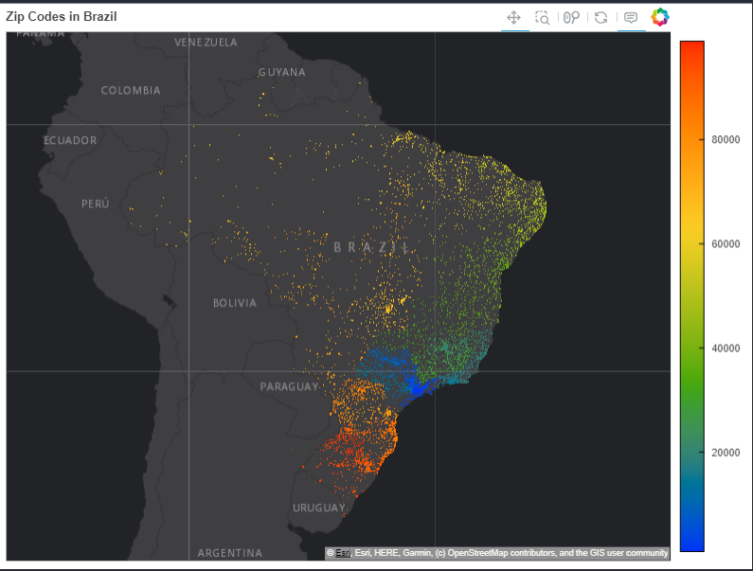
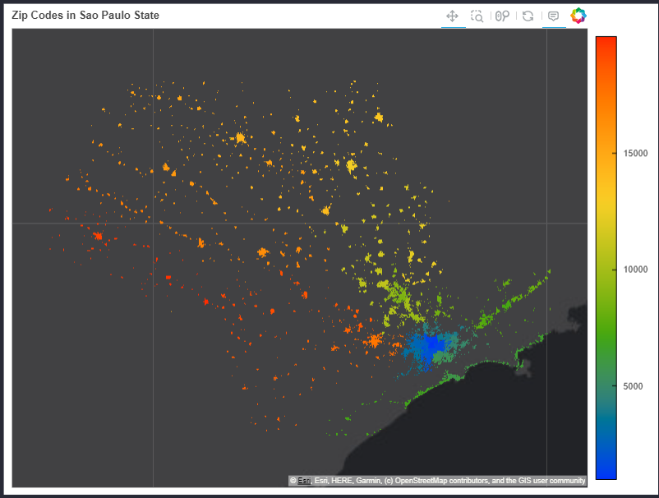
São Paulo

Slide 15
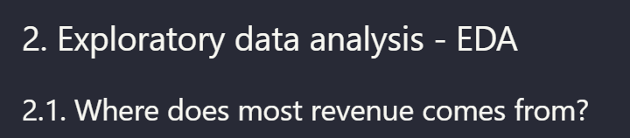
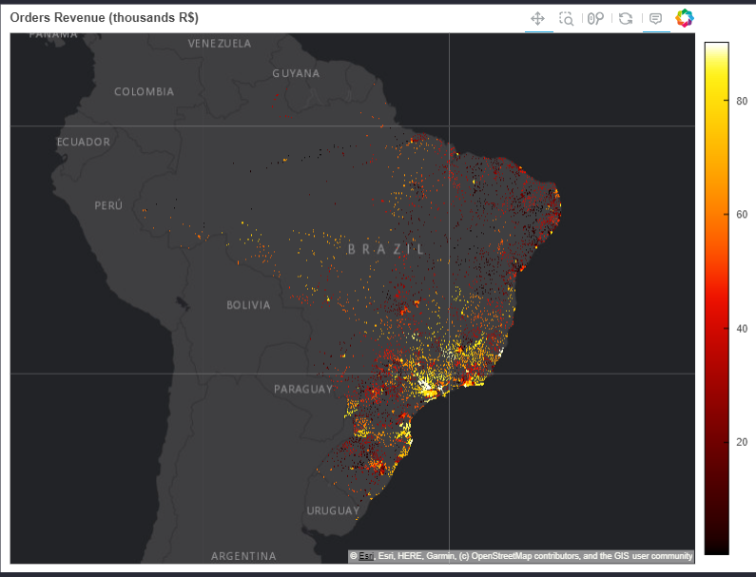

Slide 16
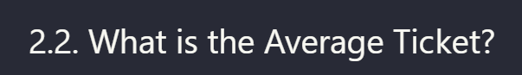
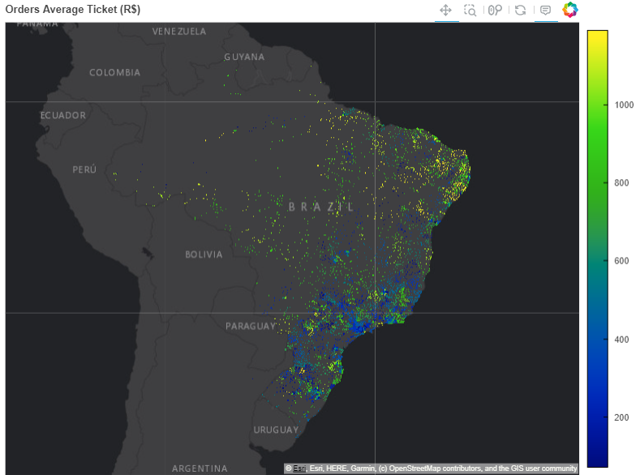
Here we see something somehow unexpected. Customers of the south and southeast regions of Brazil have lower average ticket, than their peers on north and norteast. This might happen because they have to pay more for freight

Slide 17
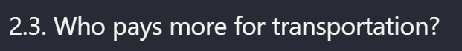
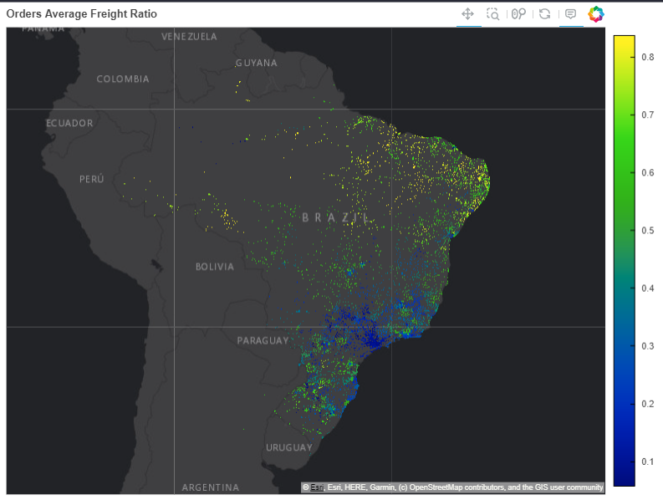

Slide 18

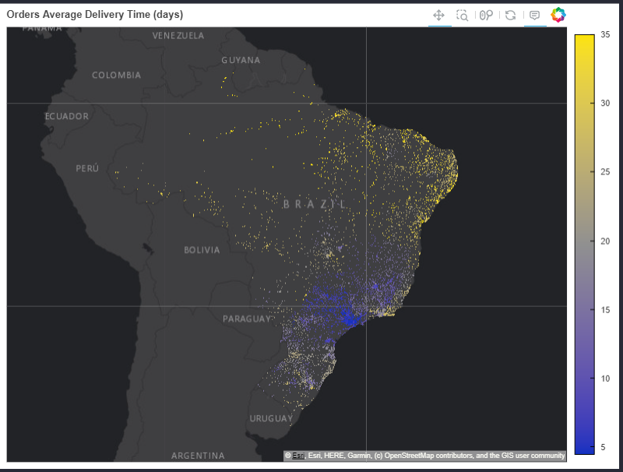

Slide 19
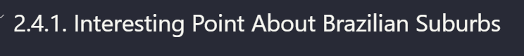
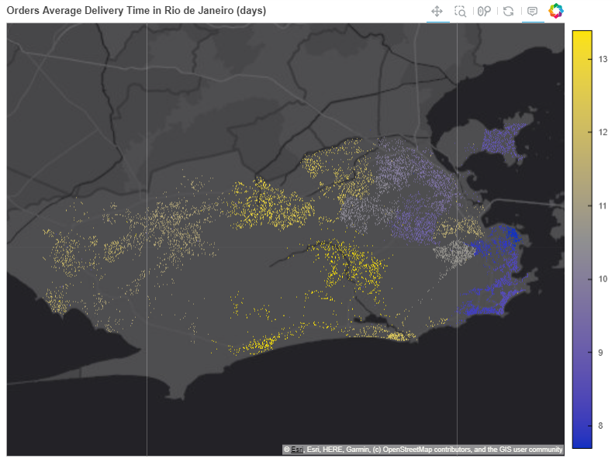

Slide 20
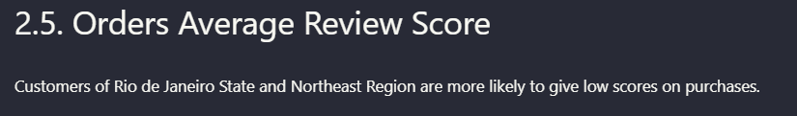
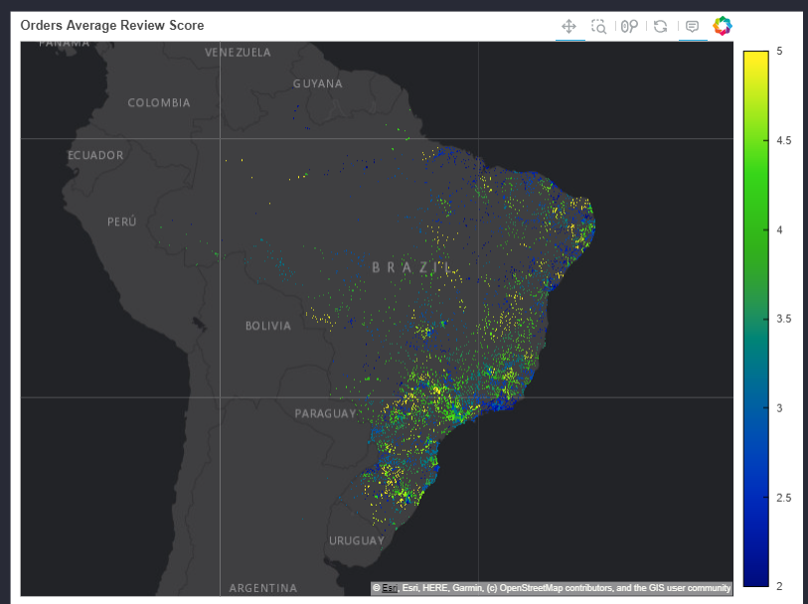

Slide 21



Slide 22
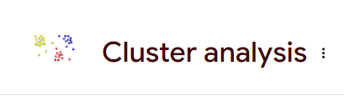

Slide 23
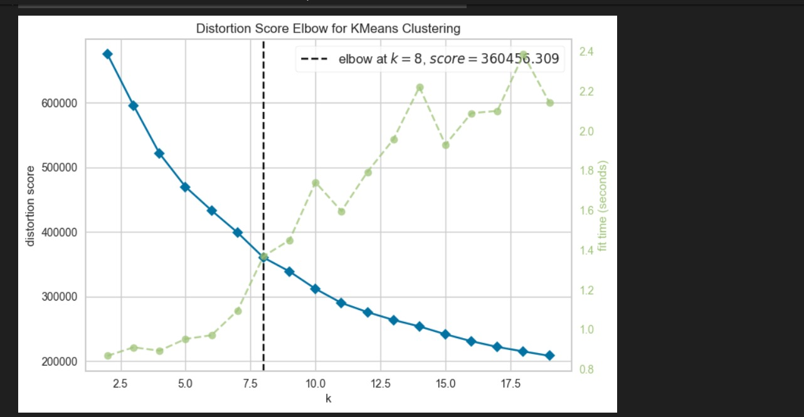

Slide 24
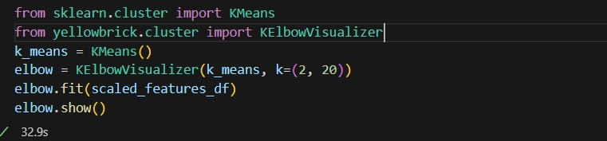
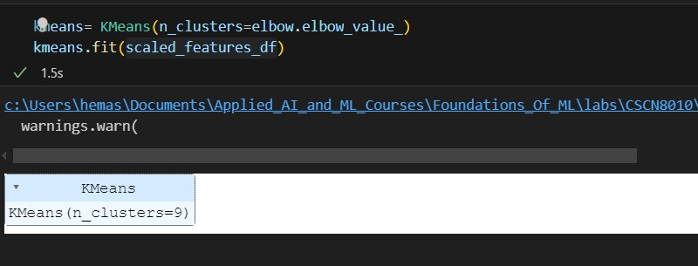

Slide 25
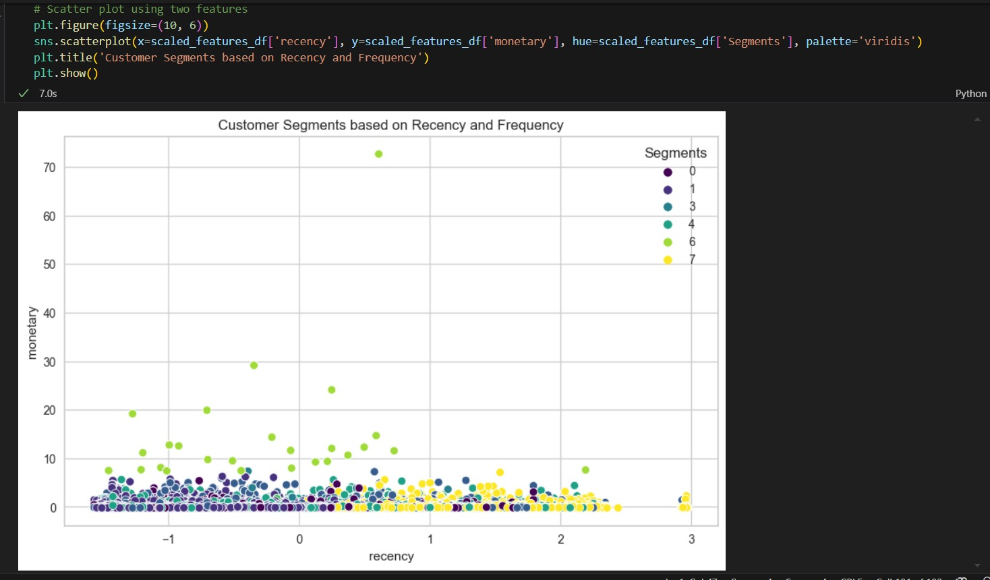

Slide 26
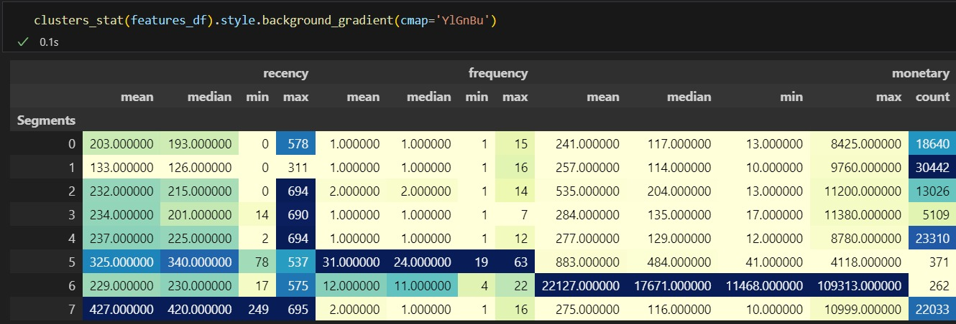
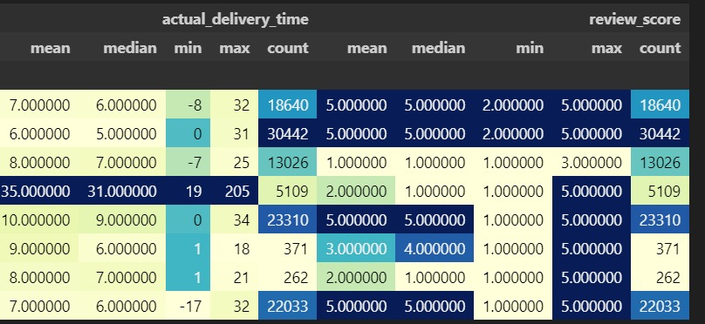

Slide 27
Insights/ strategies we come up with customer segmentation
Key Observations
High Review Scores: Segments 0, 1, 4 and 7 have high review scores mean of 5.00000 despite having low frequency and moderate spending. This indicates high customer satisfaction among these segments.
High Spending: Segment 6 stands out with extremely high spending with a mean of 22127.000000 and a max of 109313.000000, which may indicate high-value customers. However, their review scores mean of 3.00000 lower than other segments.
Delivery Time: Segment 3 has a significantly higher mean (35.000000 ) delivery time compared to others, which might correlate with their low review scores that has a mean of mean 3.000000.
Recency: Segments with higher recency (more days since last purchase) Segment 7 mean of 427.000000 might need targeted marketing to re-engage them.

Slide 28
Insights/ strategies we come up with customer segmentation
Recommendations
Target Segment 6: Focus on improving the experience for high-value customers in Segment 6 to boost their review scores and loyalty.
Re-engage High Recency Segments: Develop marketing strategies to re-engage customers in Segments 4, 5, and 7 who have not purchased recently.
Address Delivery Issues: Investigate and address the delivery delays in Segment 3 to improve their satisfaction and review scores.

Slide 29

Thank you for your attention.
Any questions?

